Slide 1
Student sheets
Sinking island
Sheet no. | Title | Notes
SS1 | Kiribati – sink or survive? | Reusable
SS2 | Are humans to blame for climate change? | Consumable. One per group.
SS3 – SS6 | Climate change statements | Reusable. Cut each student sheet in half. Laminate and display around the room.

Slide 2
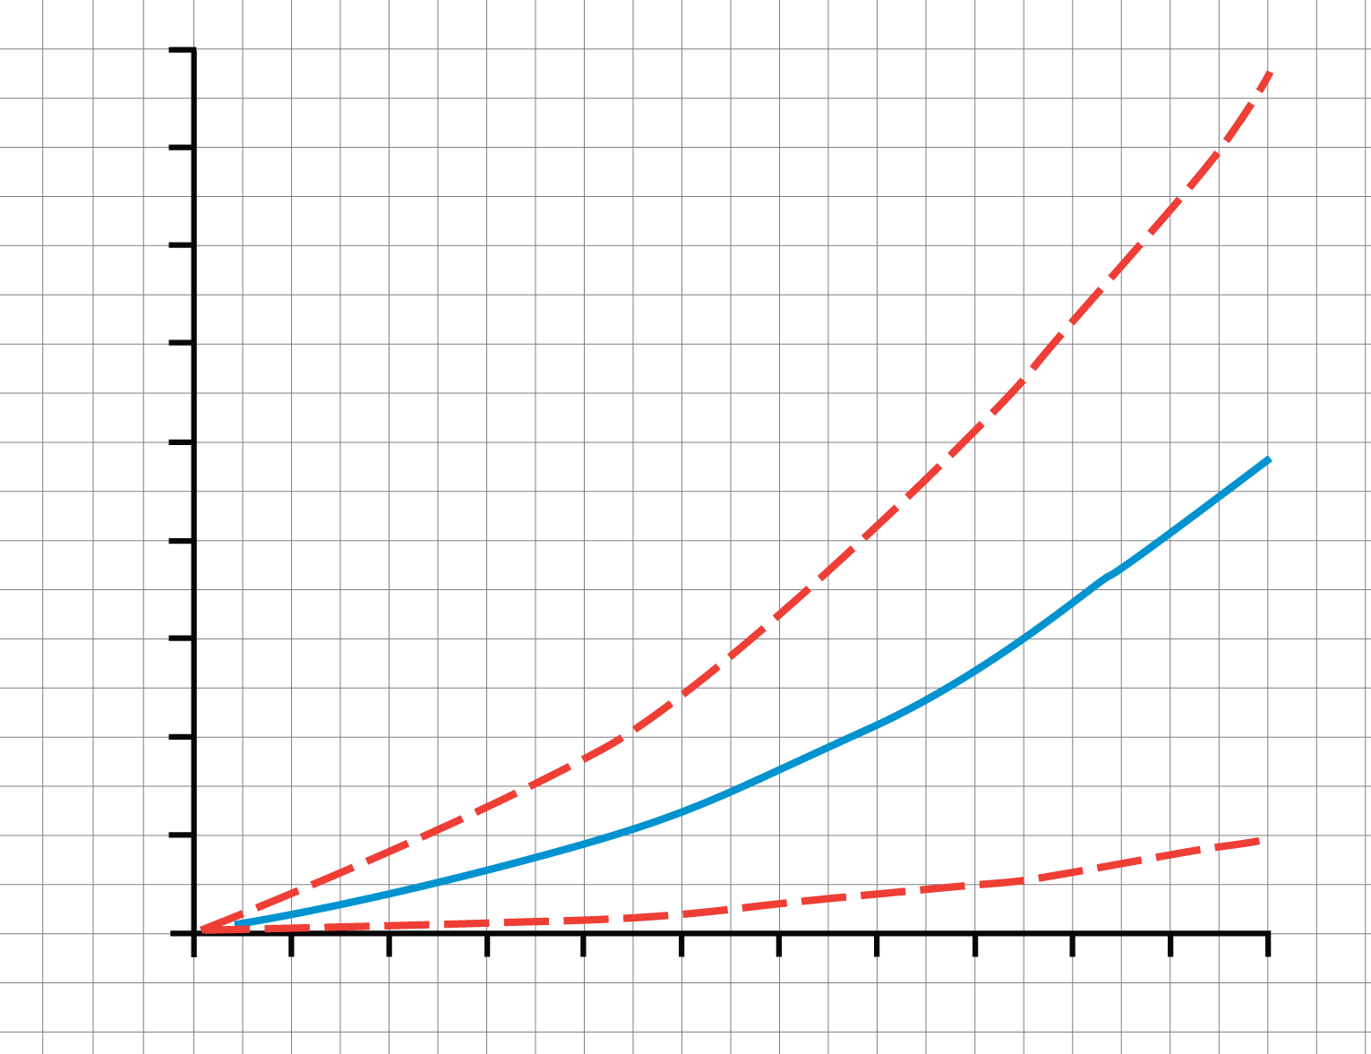
SS1
Kiribati – sink or survive?
What to do
1 Read this page. Why do scientists not know the values of future input variables?
Kiribati
On most islands the highest point is less than 3 m above sea level.
Thousands of people live on land that is 40 cm or less above sea level.
2 On the graph:
Use the solid line to predict when the sea will cover land that is 40 cm or less above sea level.
Use the left dotted line to predict the earliest year the sea is likely to cover land that is 40 cm or less above sea level. How old will you be then?
Use the solid line to find the average predicted sea level rise by 2030.
Use the dotted lines to find the maximum and minimum predicted sea level rises by 2030.
Write down the predicted sea level rise by 2030 as an uncertainty.
Work out the predicted sea level rise by 2080, and write it as an uncertainty.
Part of a Kiribati island
3 m
40 cm
90
80
70
60
50
40
30
20
10
0
Maximum predicted sea level rise
Predicted sea level rise
Uncertainty
Scientists run computer models to predict sea level rises for different years.
For any one year, say 2040, they cannot know the values of input variables such as carbon dioxide concentration. So scientists input maximum and minimum predicted values for these variables.
The different values for each variable give a range of predictions for sea level rise by 2040 (4 to 24 cm.)
This range of values for the prediction is expressed as an uncertainty:
Predicted sea level rise by 2040 = (14 cm ± 10 cm)
Average predicted sea level rise
Predicted sea level rise since 1990 (cm)
Minimum predicted sea level rise
1990 2000 2010 2020 2030 2040 2050 2060 2070 2080 2090 2100
year

Slide 3
SS2
Are humans to blame for climate change?
Study the statements around the room. Write the letter of each statement in one column.
Weigh up the evidence and make a conclusion: are humans to blame for climate change?
Discuss: How confident are you in your conclusion? For help, see can we be sure...
Statements that are opinions | Evidence that climate change is happening | Evidence that humans are to blame for climate change | Evidence that humans are not to blame for climate change
Can we be sure…
how much carbon dioxide (and other greenhouse gases, like methane) come from human activities?
how greenhouse gases affect global temperatures?
how other factors affect global temperatures?

Slide 4
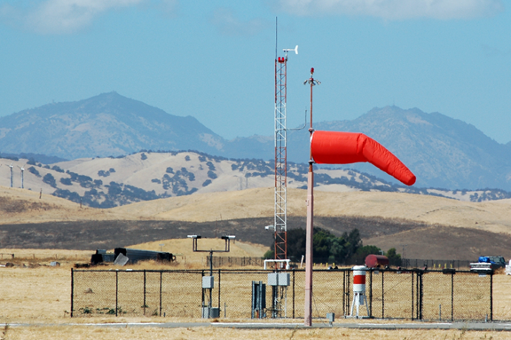
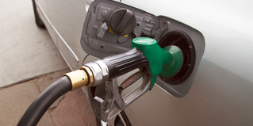
SS3
Climate change statements
Statement A
Statement B
Time period | Average CO₂ emissions from burning fossil fuels (gigatonne of CO₂ / year)
1990 – 1999 | 23.5 ± 1.5
2000 – 2005 | 26.4 ± 1.1
We analysed data from weather stations all over the world.
The data show that the global average temperature is 0.8 ºC higher now than it was 100 years ago.
Data from the Intergovernmental Panel on Climate Change report, 2014
Hadley Centre for Climate Change, UK

Slide 5
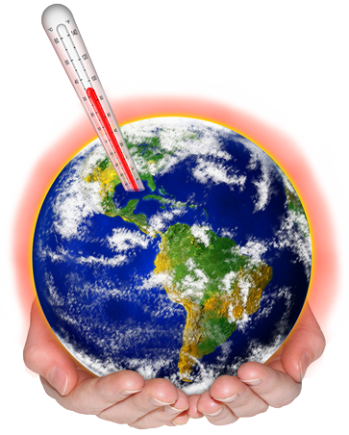
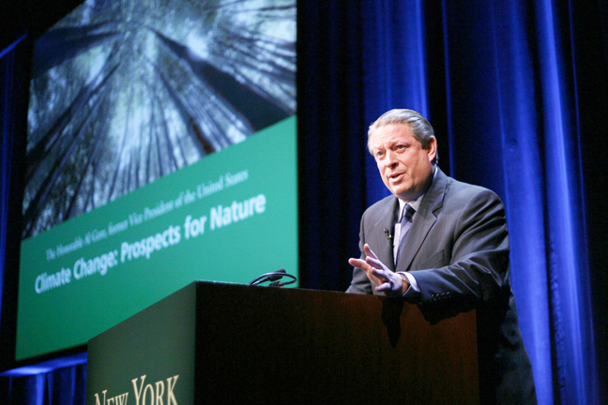
SS4
Climate change statements
Statement C
Statement D
Nobody will do anything about climate change unless they are convinced humans are responsible for it.
The total global temperature increase from 1850-1899 to 2001-2005 is 0.76 ºC ± 0.19 ºC.
Al Gore, former US vice-president
Intergovernmental Panel on Climate Change report, 2014

Slide 6
SS5
Climate change statements
Statement E
Statement F
Year | Concentration of methane in the atmosphere (parts per billion)
1750 | 715
1990 | 1732
2005 | 1774
Climate change is too complicated to be caused by just one factor.
It is governed by hundreds of factors, including the Sun, volcanoes, water vapour, methane, carbon dioxide and atmospheric dust.
Methane is a greenhouse gas. It is produced by cattle and growing rice.
Philip Stott retired professor of biogeography
Data from the Intergovernmental Panel on Climate Change report, 2014

Slide 7
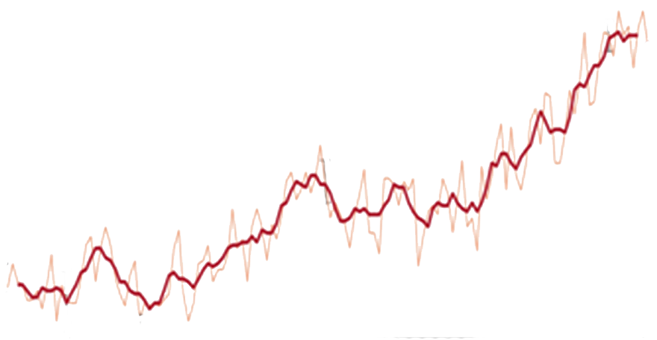
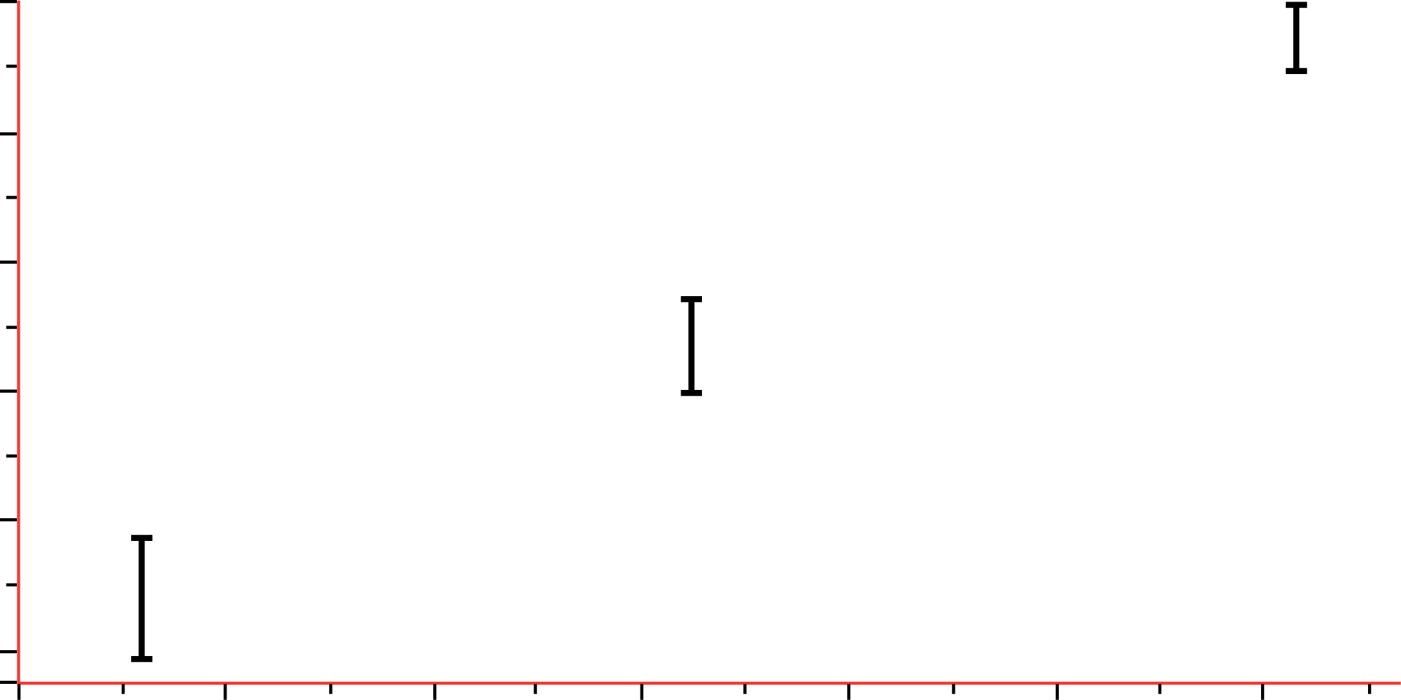
SS6
Climate change statements
Statement G
Statement H
0.6
0.4
0.2
0
–0.2
–0.4
Global temperature
Significant changes in climate have continually occurred throughout time
Global temperature difference (ºC)
uncertainty
1880 1900 1920 1940 1960 1980 2000
2
0
–2
–4
–6
year
Global average temperature compared to present (ºC)
The graph shows the global temperature difference compared to the average temperature between 1951 and 1980.
The vertical black lines show uncertainty.
0.8 0.7 0.6 0.5 0.4 0.3 0.2 0.1 0
Time (millions of years before present)
Last Ice Age
Graph credit: NASA
Graph from NASA
The European Foundation

